Slide 1

Nebraska VR

Slide 2

Business Engagement Structure
Capacity building training for Customized Employment, Job Task and Work Site Analysis
On-going Collaboration with Service Providers (CRP’s)

Slide 3
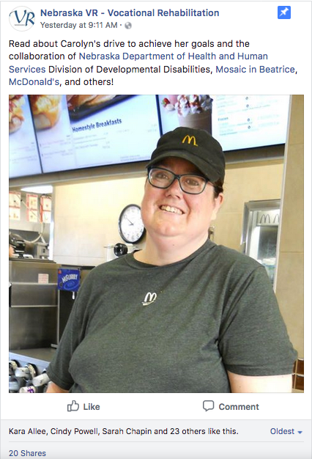
BE Approaches
VCU Training
Break-Out Sessions at State Staff Training from Iowa VR
State-Wide Transition/Pre-ETS Conference Presentation
Developed VR Profile
Success Videos
Success Stories in Print Form (Shared on DD website, VR Newsletter and Social Media feeds)
Quarterly Video Conference Meetings held for updates, Q & A, staffing difficult cases

